Slide 1
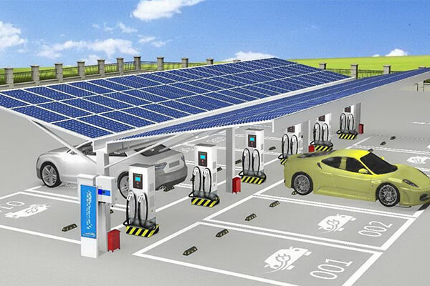

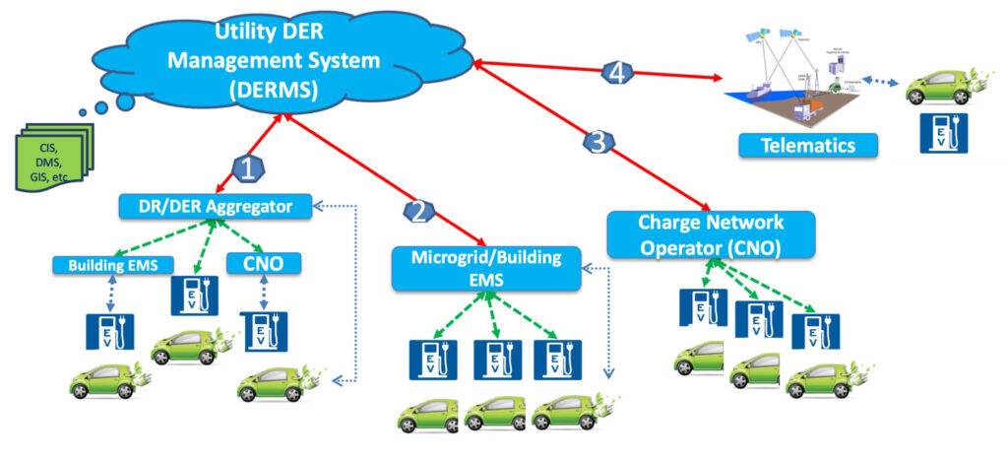
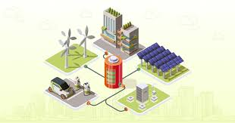

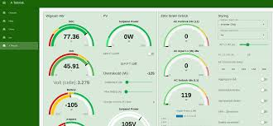
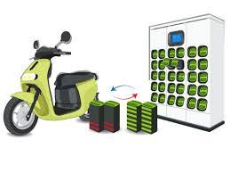
Title –
Design of IOT Architecture for Battery Charging Management System
Presentation on Major project
2nd Sem – Review -1
Presented by
Jagadeesh_(AP2312210002)
under the Esteemed guidance of
Dr. Sujith Kalluri Ph.D
Associate Professor
School of Engineering and Sciences (SEAS)
Department of Electronics and Communication Engineering
SRM University, Andhra Pradesh (SRM AP)

Slide 2



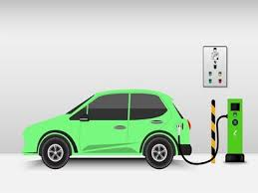

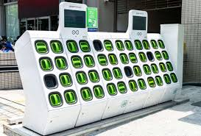




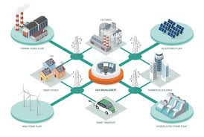
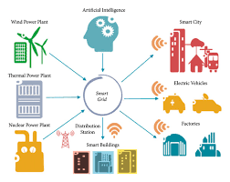
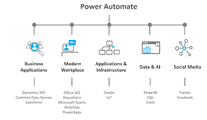
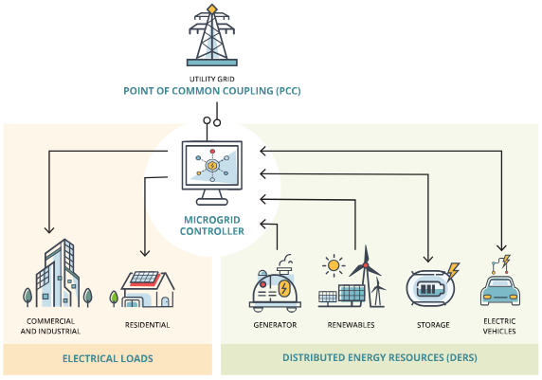
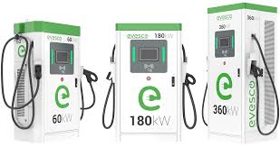
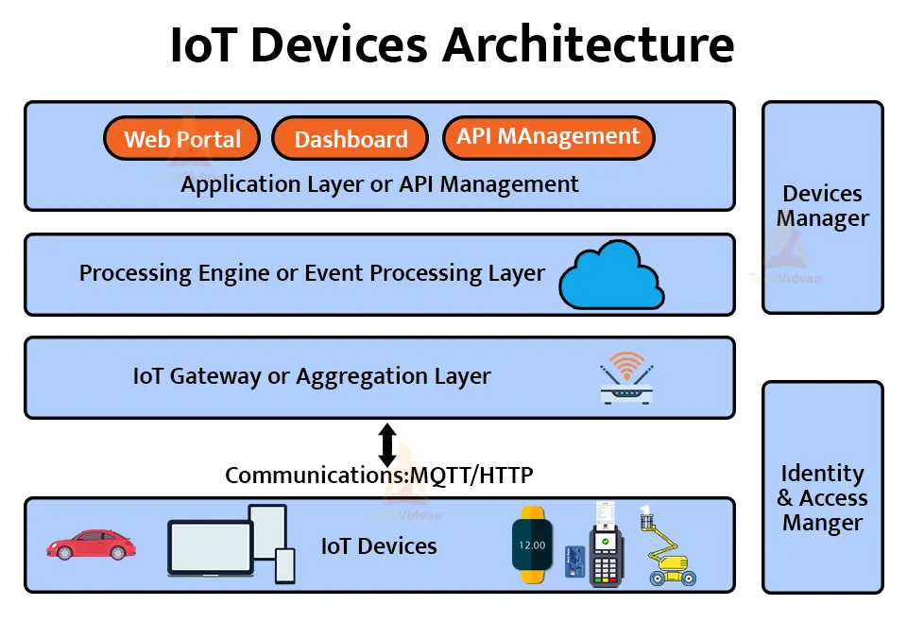

Outline
Industry Study case
EV Charging Station
ESS
Swapping
IOT
2_1 → Revied Work
Introduction
Literature survey
Research gap
Objective
Problem formulation
Proposed Methodology
Present ongoing work status
Conclusion
Future Outcomes
References
IOT Connectivity
Real Time monitoring
Load management
Grid Stability
Algorithm
Cloud
AWS
Integration
Automation
Swapping
DC Charging
IOT Architecture
PCC

Slide 3

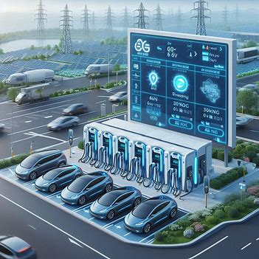
Introduction
Lack of Pollution – need More Transportation – Need coal mines – More Generation cost
Why IOT needed
Real Time Data Monitoring
Pre estimation Power Demand
To Reuse Harmonic's Imbalance
Central Monitoring System
End User Integration
EV are Rapidly Increasing in the world Automotive Market
So, There is a Demand of Charging Infra

Slide 4

2.1 Semester work
Project Title
Design of IOT Architecture for Battery Charging Management System
Problem Statement
Increasing of EV Charging Infra
Power Grid Instability
Real Time Monitoring
Load Management
Data Monitoring
High operational cost
Literature survey
4 – EV Charging Startup companies
EV Charging Stations
Energy Storage Systems
Battery Swapping Stations
IOT Integration
Sensing and Monitoring
Machine Learning Approach
Research gap / Market Requirements
IoT Connectivity
Real Time Monitoring
Power Load Management
Grid Stability
Integration & Automation
Cloud Data Storage
Proposed Methodology
IOT Architecture for Battery charging management
PCC integration and Automation
Algorithms
Designed Proposed Simulation Model in MATAB Simulation
Integrated PCC –Fully Automated & Logically connected
Swapping Station and DC Fast Charging
Central Monitoring Station
Estimated Calculated Spread sheet of Cost and Energy
Core work
Integration of 3 Power Sources
Automation on sources availability
30 no’s of EV Swapping Station
4 units of DC Charging station
Remote monitoring with Node-red
AWS Cloud Integration
1 -------------
Anveshan – Zonal Level
Outcomes
Energy Saving – 88.6%
Cost Saving – 88.5%
Research Paper
H/W_ Prototype Implementation

Slide 5
Literature Review
Industry Study case
Akkodis
AI-based battery diagnosis
Modular, interchangeable batteries with cloud-based BMS
Predictive analytics for optimal charging and utilization
Elmelin
IoT-enabled thermal management
Real-time data analysis for proactive maintenance
Integration with smart grids for bidirectional energy flow
Zypp Electric
Fleet management and charging infrastructure
Sustainable charging with renewable energy integration
User-friendly mobile apps for charging access and battery health
E Drift
Smart charging stations with IoT-based monitoring
Data analytics for battery performance assessment and maintenance prediction
Integration with mobility services for seamless user experiences

Slide 6
Literature Review
Charging Station
Research Paper Title | Literature Review
IoT Solutions for Electric Vehicles (EV) Charging Stations: A Driving Force Towards EV Mass Adoption Sayantika Sikdar; Madhavi Damle | The paper discusses the growth of Electric Vehicles (EVs). It highlights the need for more EV charging stations. Range anxiety is a significant barrier to EV adoption. IoT technology can enhance EV charging station development. Continuous monitoring can prevent battery damage during charging. Intelligent charging stations optimize EV admission and scheduling. IoT solutions can improve security and theft management.
Power Quality Enhancement in Integrated Grid for EVs Charging Stations Using Active Filter Ajay Kumar; O.P. Rahi; Ram Niwash Mahia | The paper discusses electric vehicles' impact on power quality. It examines harmonic distortion in voltage and current waveforms. Active filters are proposed for mitigating total harmonic distortion. The study emphasizes the need for effective power infrastructure. MATLAB Simulink is used for simulation and analysis. Results show significant THD reduction with active filters.
Residential Electric Vehicle Charging Station Using the Internet of Things Ashutosh Vijay Panchbhai; Ramakrishnan Raman; Chintan Bhupeshbhai Thacker | The literature review examines challenges in household EV charging infrastructure. High installation costs hinder EV adoption in residential areas. Scarcity of charging ports slows home EV adoption rates. IoT technology enhances accessibility and efficiency of charging stations. Intuitive interfaces improve user experience for EV owners. Flexible deployment options are crucial for residential charging solutions. Efficient payment processing systems are necessary for user convenience. Previous research highlights barriers to widespread home charging station adoption. The review supports a holistic approach to EV charging solutions. The proposed system aims to address identified challenges effectively.
IoT enabled E-Vehicle Charging System with Battery Monitoring and Charge Scheduling S. Arulmozhi; M. Abiramavalli; M.B.Diviya Bhavaani; S. Loganayagi | Energy management technologies are pivotal in optimizing energy efficiency within the renewable energy sector. These technologies encompass tasks such as energy information collection, economic analysis, and operational strategies, underscoring the importance of comprehensive energy management systems When determining the optimal capacity for an Energy Storage System (ESS), it is crucial to consider various factors beyond numerical calculations. Factors such as ESS characteristics, lifespan, and operational considerations should be taken into account to make informed and cost-effective decisions regarding ESS capacity planning

Slide 7
Literature Review
Energy Storage Systems
Research Paper Title | Literature Review
ESS Simulation based on PV Generation Prediction Tai-Yeon Ku; Wan-Ki Park; Hoon Choi | Energy management technologies such as energy information collection, economic analysis, and operation play a crucial role in maximizing energy efficiency in the renewable energy business To calculate the most economical Energy Storage System (ESS) capacity, it is essential to consider factors like ESS characteristics, lifespan, and operational aspects rather than just numerical calculations
Solar
Research Paper Title | Literature Review
A Pitaya Dye-Sensitized Solar Cell Monitor for Environmental Sunlight Intensity Detection Cheng-Ta Chiang; Liang-Yu Chien | Energy management technologies are crucial for optimizing energy efficiency in the renewable energy sector. These technologies involve tasks such as energy information collection, economic analysis, and operational strategies, emphasizing the significance of comprehensive energy management systems When determining the optimal capacity for an Energy Storage System (ESS), it is essential to consider various factors beyond numerical calculations. Factors like ESS characteristics, lifespan, and operational aspects should be taken into account to make informed and cost-effective decisions regarding ESS capacity planning
Eternal-Thing: A Secure Aging-Aware Solar-Energy Harvester Thing for Sustainable IoT Saswat Kumar Ram; Sauvagya Ranjan Sahoo; Banee Bandana Das | The paper combines energy-awareness and security-awareness for IoT. Existing literature focuses on either energy or security, not both. Solar energy is advocated for ultra-low-power harvesting systems. DC-DC converters and MPPT are essential for power conditioning. Capacitor value modulation aids in impedance matching. Aging analysis of secure EHS is necessary for long-term operation.

Slide 8
Literature Review
Grid
Research Paper Title | Literature Review
IoT-based optimization of microgrid operation Abdelrahman Ahmed; Sobhy Abdelkader; Ehab Ayman | Energy management technologies are crucial for maximizing energy efficiency in the renewable energy sector. These technologies involve aspects such as energy information collection, economic analysis, and operational strategies When determining the optimal capacity for an Energy Storage System (ESS), it is important to consider various factors beyond numerical calculations. Factors such as ESS characteristics, lifespan, and operational considerations should be taken into account for cost-effective decisions
An Efficient LoRa-Enabled Smart Fault Detection and Monitoring Platform for the Power Distribution System Using Self-Powered IoT Devices Isa Hafidz; Ardyono Priyadi; Margo Pujiantara; Dimas Okky Anggriawan | The literature review covers fault monitoring in power distribution systems. Various approaches include Petri nets, fuzzy methods, and neural networks. Expert systems face challenges in maintaining knowledge bases. Neural networks struggle with interpreting reasoning results. Fuzzy theory is susceptible to subjective tendencies. Petri-based methods have poor adaptability and online modeling issues. Previous studies focused on IoT's role in power maintenance.
Development of IoT-Based Portable Power Quality Monitoring on Microgrids by Enhancing Protection Features Tianxin Zhuang; Ming Ren; Xuze Gao; Ming Dong; Wenguang Huang | The paper explores power quality and protection features in microgrids. It discusses challenges in microcontroller-based microgrid protection schemes. Coordination schemes for non-standard tripping characteristics are developed. The impact of renewable energy on network architecture is analyzed. Power quality issues affecting equipment life and costs are highlighted.
Insulation Condition Monitoring in Distribution Power Grid via IoT-Based Sensing Network Tianxin Zhuang; Ming Ren; Xuze Gao; Ming Dong; Wenguang Huang | Energy management technologies such as energy information collection, economic analysis, and operation play a crucial role in maximizing energy efficiency in the renewable energy business To calculate the most economical Energy Storage System (ESS) capacity, it is essential to consider factors like ESS characteristics, lifespan, and operational aspects rather than just numerical calculations
Internet of Things-Aided Smart Grid: Technologies, Architectures, Applications, Prototypes, and Future Research Directions Yasir Saleem; Noel Crespi; Mubashir Husain Rehmani; Rebecca Copeland | The survey covers IoT-aided smart grid systems comprehensively. It discusses existing architectures for IoT-aided smart grids. Applications of IoT-aided smart grids are detailed in the literature. Previous surveys on IoT and smart grids are reviewed. The paper identifies gaps in literature on IoT-aided smart grids.

Slide 9
Literature Review
Management Monitoring
Research Paper Title | Literature Review
Design of an Industrial IoT-Based Monitoring System for Power Substations Long Zhao; Igor Brandao Machado Matsuo; Yuhao Zhou; Wei-Jen Lee | The paper discusses IoT's application in various monitoring systems. IIoT enhances data collection and analysis in power systems. Real-time monitoring is critical for power system operations. Previous studies highlight IoT's role in smart grid applications. Cybersecurity is essential in IoT-based monitoring systems.
A Novel Sensor Placement Strategy for an IoT-Based Power Grid Monitoring System Joe-Air Jiang; Jen-Cheng Wang; Hung-Shuo Wu; Chien-Hsing Lee | Energy management technologies play a vital role in enhancing energy efficiency within the renewable energy sector. These technologies encompass tasks such as energy information collection, economic analysis, and operational strategies, highlighting the importance of comprehensive energy management systems When determining the optimal capacity for an Energy Storage System (ESS), it is imperative to consider various factors beyond numerical calculations. Factors such as ESS characteristics, lifespan, and operational considerations should be taken into account to make informed and cost-effective decisions regarding ESS capacity planning
State-of-Charge Equalizations Comparison in a Multi-prosumer Environment Based on Real-Time Energy Management Systems with IoT-Support Enrique A. Sanabria-Torres; Adriana C. Luna; Nelson L. Diaz; Fabio Andrade-Rengifo | Energy management technologies are essential for optimizing energy efficiency in the renewable energy sector. These technologies encompass tasks such as energy information collection, economic analysis, and operational strategies When determining the optimal capacity for an Energy Storage System (ESS), it is crucial to consider various factors beyond mere numerical calculations. Factors like ESS characteristics, lifespan, and operational aspects should be taken into consideration for making cost-effective decisions
Intelligent IOT-based BMS for Integrated Solar with AC grid Fast Charging Systems in Electric Vehicles Shreyas Thombare; Pankai Kumar; Raiashree Bhokare; Sachin Jadhav | The paper reviews fast charging systems for electric vehicles. It discusses limitations of existing charging technologies. Various advanced battery management techniques are highlighted. Previous studies on supercapacitor charging systems are mentioned. Future aspects of electric vehicle charging are explored.

Slide 10
Literature Review
Management Monitoring
Research Paper Title | Literature Review
IoT Based Electrical Vehicle Battery Management System with Charge Monitor and Fire Protection Santosh Kumar Tripathi; Swati Maurya; Aditi Dubey; Prakhar Pal; Aparna Tiwari | Focuses on large scale Li-ion battery management systems. Discusses cloud computing algorithms for battery management systems. Covers real-time monitoring of voltage, current, and temperature. Proposes IoT solutions for Li-ion battery venting. Highlights network impact from electric vehicles during charging. Describes wireless battery monitoring system for SOC estimation. Evaluates adaptive SOC estimation methods for battery management. Reviews advantages of Li-ion batteries for electric vehicles.
An IoT -based Power Management System for EV Chargers Vimalarani G; Kavitha B C; Shaik Nihal; K Rakesh | Current transformer sensor extracts current details via Arduino. T. Juhana et al. displayed voltage and power using Bluno. S. Ren et al. discussed voltage display via LCCR meter. S. E. Princy et al. transferred data between Arduino and Raspberry Pi.
Swapping Station
Research Paper Title | Literature Review
Optimal Planning of Battery Swapping and Charging Stations for the Urban Cities Sachin Shivaji Kumbhar; Vaiju N. Kalkhambkar | Previous research focused on battery swapping or charging stations separately. Integration of both battery swapping and charging stations is necessary. Optimal placement of battery swapping stations has been explored. Mixed-integer nonlinear programming has been used for sizing and location. Government initiatives are promoting the use of battery electric buses.
Combining data centers with electric vehicle battery swapping stations for grid regulation Shan Zhang; Xiaoshan Sun; Hengchang Liu | The paper combines data centers with EV battery swapping stations. It focuses on grid regulation using battery swapping stations. Previous solutions emphasized charging stations, neglecting battery swapping. The study proposes novel algorithms for decision-making. Simulation results show significant grid imbalance reduction.
Battery Swapping Mobile Service Station for Electric Vehicles Application Bansilal Bairwa; Mrinal Sarvagya; Sanjeeva Kumar | The paper presents a novel battery swapping service approach. It establishes structural architecture for efficient swapping services. It differentiates between charging stations and swapping stations. It describes the mobile swapping unit's working mechanism. It outlines user communication via a mobile application. It analyzes power consumption and runtime of the swapping unit.

Slide 11
Literature Review
Swapping Station
Research Paper Title | Literature Review
Optimal dispatch of electric vehicle batteries between battery swapping stations and charging stations Xian Zhang; Guibin Wang | Research on battery swapping stations (BSS) is underdeveloped. Existing studies treat BSS as common load, ignoring unique characteristics. Battery logistics between BSS and battery charging stations (BCS) is urgent. EV charging demand impacts power system operation negatively. Long charging times reduce consumer willingness to buy EVs.
Integration of Battery Swapping Station into Microgrid: A Review Prasanta Kumar Mohanty; Premalata Jena; Narayana Prasad Padhy | Monte Carlo simulation compares BSS and EV charging stations. Generalized Benders decomposition minimizes charging costs for EV demand. Battery standardization and deployment discussed during planning stages. BSS locations selected using GPS data and clustering techniques. Multi-objective optimization techniques optimize cost and economic aspects. PV-based BSS systems verify day-ahead scheduling for cost minimization. Optimal routing and scheduling of BSS for e-buses analyzed. BSS can act as an Energy Storage System for microgrids. Challenges in BSS implementation and optimization models are discussed. Recent research highlights advantages of BSS over conventional charging methods.
Location Decision of Battery Swapping Stations Combined with Battery Swapping Warehouses Qinxuan Huang; Xuan Zhang | Energy management technologies are pivotal in optimizing energy efficiency within the renewable energy sector. These technologies encompass tasks such as energy information collection, economic analysis, and operational strategies, underscoring the importance of comprehensive energy management systems When determining the optimal capacity for an Energy Storage System (ESS), it is crucial to consider various factors beyond numerical calculations. Factors such as ESS characteristics, lifespan, and operational considerations should be taken into account to make informed and cost-effective decisions regarding ESS capacity planning

Slide 12
Literature Review
Machine Learning
Research Paper Title | Literature Review
Machine_Learning-Based_Method_for_Remaining_Range_Prediction_of_Electric_Vehicles Liang Zhao; Wei Yao; Yu Wang; Jie Hu | There is no common dataset for range prediction. Previous works lacked benchmarks like those in computer vision. Tests in prior studies were iterative and varied. Cell inconsistency affects state of health (SOH) estimation. Manufacturing variations lead to battery performance inconsistencies. Range anxiety is a concern for electric vehicle drivers.
Prediction_of_EV_Charging_Behavior_Using_ Machine_Learning Sakib Shahriar; A. R. Al-Ali; Ahmed H. Osman; Salam Dhou | Energy management technologies play a crucial role in enhancing energy efficiency in the renewable energy sector. These technologies involve tasks such as energy information collection, economic analysis, and operational strategies, highlighting the importance of comprehensive energy management systems When determining the optimal capacity for an Energy Storage System (ESS), it is essential to consider various factors beyond numerical calculations. Factors such as ESS characteristics, lifespan, and operational aspects should be taken into account to make informed and cost-effective decisions regarding ESS capacity planning
Reinforcement_Learning_Based_EV_Charging_ Management_SystemsA_Review Abdullah, Heba M. Gastli, Adel Ben-Brahim, Lazhar | The review includes journal articles, conference papers, and dissertations. Contributions primarily come from China, the US, and Canada. China leads in global EV market shares and sales. Studies focus on EV charging coordination using RL techniques. Uncertainties in EV load demand challenge scheduling approaches. A local optimal scheduling scheme is proposed for EVs.

Slide 13
Literature Review _ Research gaps
Grid Integration
Fault detection and monitoring
IoT-based optimization of microgrid operations
Power quality enhancement using active filters
Management Monitoring
Real-time monitoring criticality
IoT-based monitoring
Machine Learning
Need for range prediction
Charging behavior prediction
Power quality monitoring
Discuss outcomes in the context of FPGA implementations. Need for range prediction
Optimizing charging schedules
Predicting power demand
Managing load distribution
Charging Station
  Need of Renewable energy sources Integrations
  Automation on Sources availability bases
  Optimization of scheduling and admission
Solar Integration
  Awareness in solar energy harvesting
  Need for DC-DC converters
  Importance of MPPT for solar optimization
Energy Storage Systems
  ESS characteristics and lifespan considerations
  Operational aspects
  Economic analysis

Slide 14
Research Gap -- 6
1. IoT Architecture for Battery Charging Management
2. Multi-Source Power Integration
Research Gap:
Existing systems lack integrated monitoring across charging infrastructure
Limited real-time decision making for power source switching
Research Gap:
Most systems rely heavily on grid power
Limited integration of renewable sources
Improvements:
5-layered IoT architecture with device, network, edge, cloud, and application layers
Real-time automation with 5 specific switching conditions
Cloud connectivity through AWS and Node-red visualization
Improvements:
Precise power distribution: Solar (56.8%), ESS (31.7%), Grid (11.5%)
Automated source switching based on conditions
High renewable energy utilization (88.6% efficiency)
Current Limitations:
Cybersecurity considerations need strengthening
Dependency on internet connectivity for cloud features
Current Limitations:
Weather dependency for solar generation
Initial setup costs for multiple power sources

Slide 15
Research Gap
3.Charging Infrastructure Design
4. Cost Efficiency Model
Research Gap:
Most solutions focus on either swapping or charging
Poor load management between different charging methods
Research Gap:
Lack of clear economic viability in existing systems
High operational costs affecting adoption
Improvements:
Combined BSS (30 stations) and DC fast charging (4 stations)
Standardized charging parameters for different vehicles
Balanced load distribution system
Improvements:
88.5% cost saving efficiency
Clear revenue model: Rs 29,494/day
Reduced grid dependency cutting operational costs
Current Limitations:
Limited number of simultaneous charging sessions
Battery standardization challenges
Current Limitations:
Initial infrastructure investment requirements
Maintenance costs for multiple systems

Slide 16
Research Gap
5. System Scalability
6. Cloud AWS Integration
Research Gap:
Limited flexibility in existing charging infrastructures
Difficulty in adapting to growing demand
Research Gap:
Existing systems have inefficient data handling and lack real-time event-driven alerts.
Limited use of cloud resources for secure and scalable data storage.
Improvements:
Modular architecture allowing easy expansion
Cloud-based management system
Standardized protocols for future integration
Improvements:
Lightweight real-time communication via MQTT.
AWS S3 for scalable data logging and analytics.
Email notifications for anomalies and system events
AWS Quickslights for Data visualization.
Current Limitations:
Physical space requirements for expansion
Grid capacity constraints in some areas
Current Limitations:
Potential latency in cloud-dependent operations.
Dependency on stable internet connectivity for seamless data transfer.

Slide 17
Problem statement and Project Objectives
Problem Statement
Growing EV adoption is causing grid instability and poor power quality.
High operational costs and inefficient load management in charging stations.
Lack of real-time monitoring and seamless integration of multiple power sources.
Limited use of renewable energy, increasing reliance on the grid.
Cybersecurity risks in cloud-connected charging infrastructure
Project Objectives
Design a 5-layer IoT architecture combining solar (56.8%), ESS (31.7%), and grid (11.5%).
Enable automated power switching and real-time monitoring.
Improve cost efficiency by 88.5% with a mix of Battery Swapping Stations (BSS) and DC fast charging.
Enhance energy utilization with smart load balancing.
Reduce grid dependency and operational costs.

Slide 18



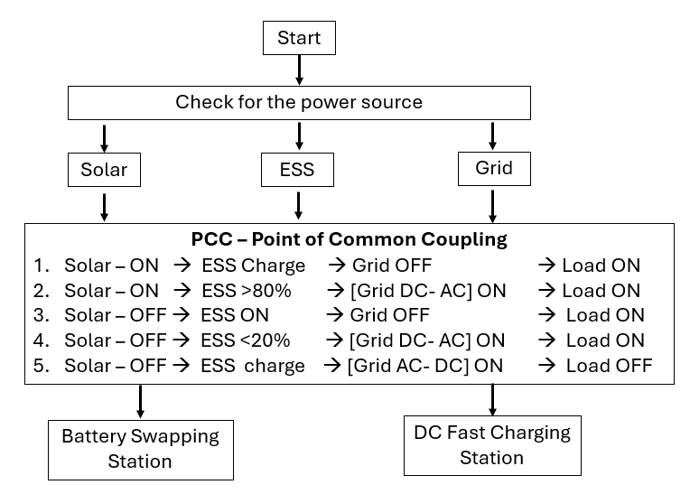
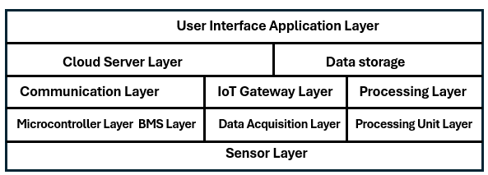
Proposed Methodology
Integration of Energy
Sources Combine renewable (solar) and non-renewable (grid) energy sources.
Utilize Energy Storage Systems (ESS) for balancing energy supply.
Automation Conditions
Define operational conditions for energy management:
Solar ON, ESS charging, Grid OFF, Load ON.
Solar ON, ESS >80%, Grid ON, Load ON.
Solar OFF, ESS ON, Grid OFF, Load ON.
Solar OFF, ESS <20%, Grid ON, Load ON.
Solar OFF, ESS charging, Grid ON, Load OFF.
IoT - 5-layer Architecture Design
Device Layer: Integrate sensors and actuators at charging stations.
Network Layer: Select communication protocols (e.g., MQTT, HTTP).
Edge Computing Layer: processing for real-time data handling.
Cloud Layer: Utilize AWS for data storage and analytics.
Application Layer: user interfaces for monitoring and management.

Slide 19
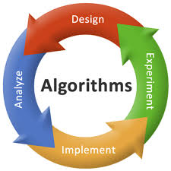
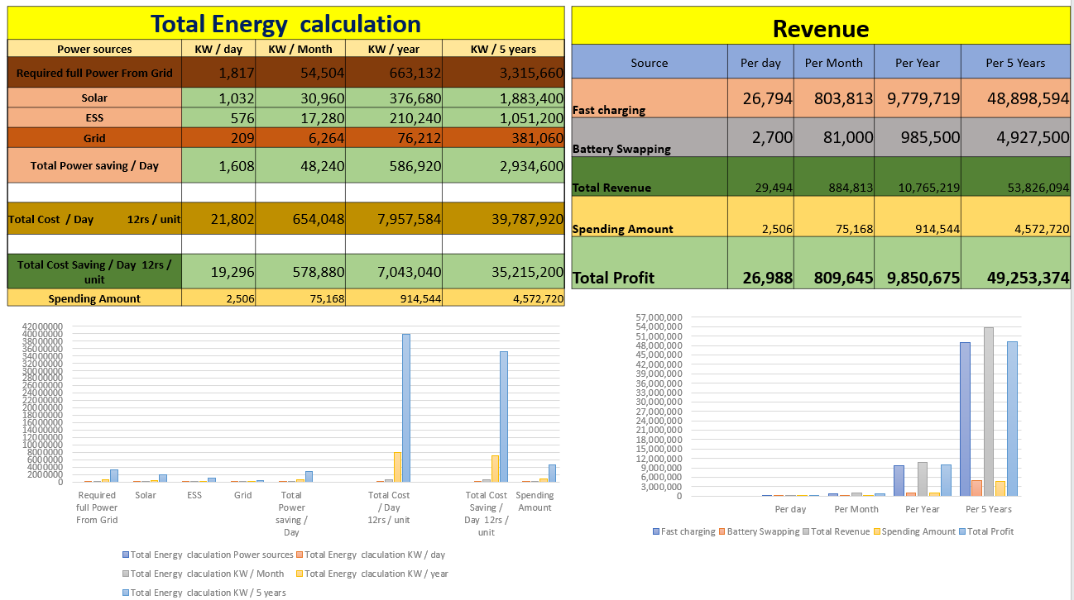
Proposed Methodology
Algorithm Development
Solar Maximum Power Point Tracking (MPPT).
Battery swapping station charging control.
DC fast charging control calculations.
Real-time monitoring with sensors.
Data Visualization and Monitoring
Use Node-RED for intranet central monitoring and data visualization dashboards.
Establish AWS connectivity for data storage and analytics.
Set up SNS service for email alerts regarding system status.
Cost and Energy Efficiency Analysis
Calculate daily energy generation from solar, ESS, and grid sources.
energy saving efficiency & cost saving efficiency based on renewable energy usage.

Slide 20
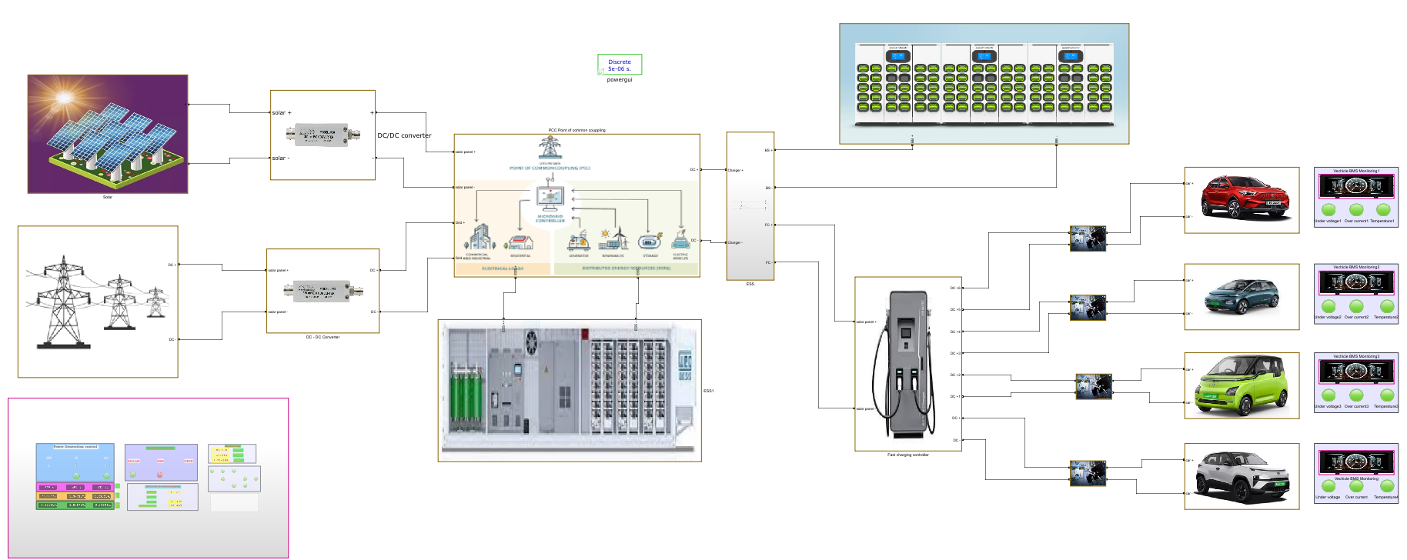
Circuit Simulation Diagram

Slide 21
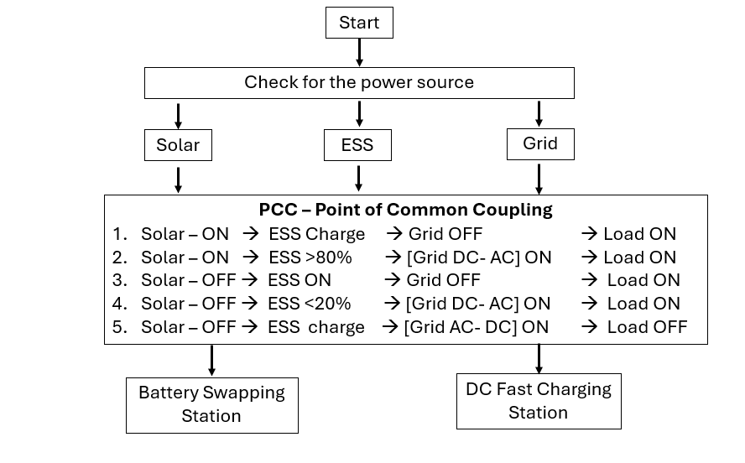
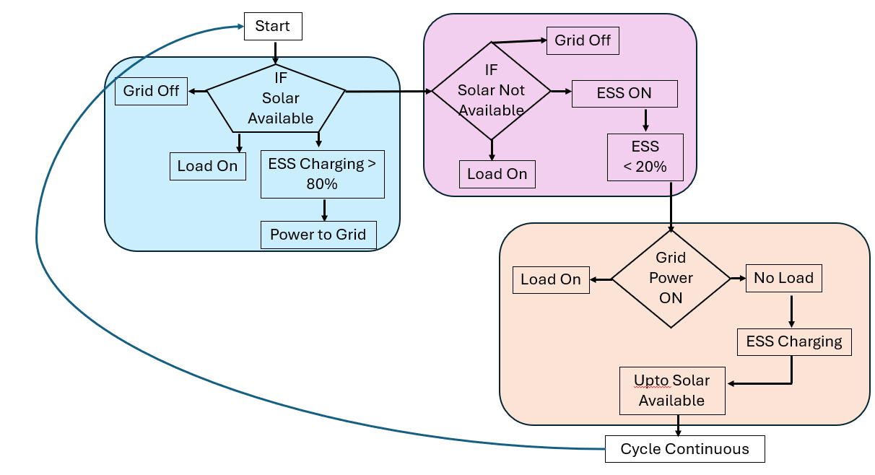
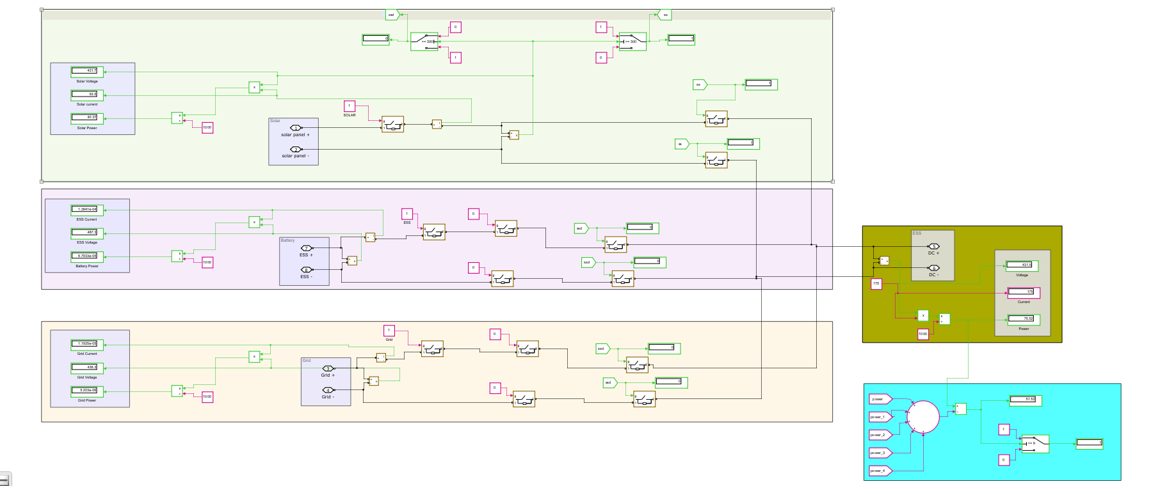
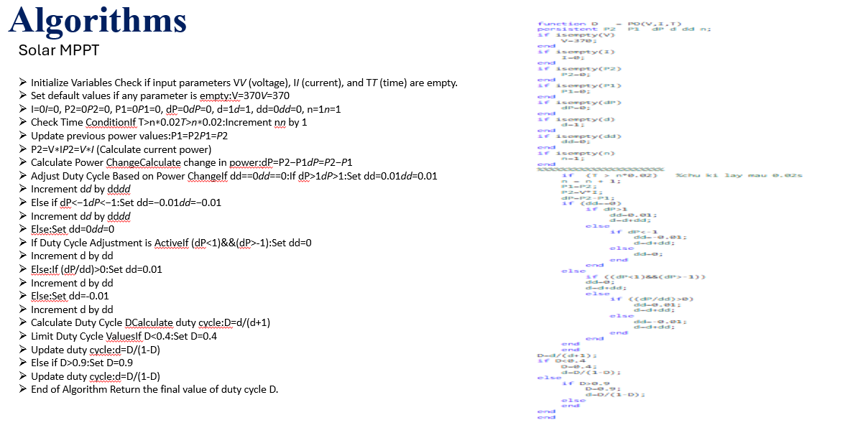
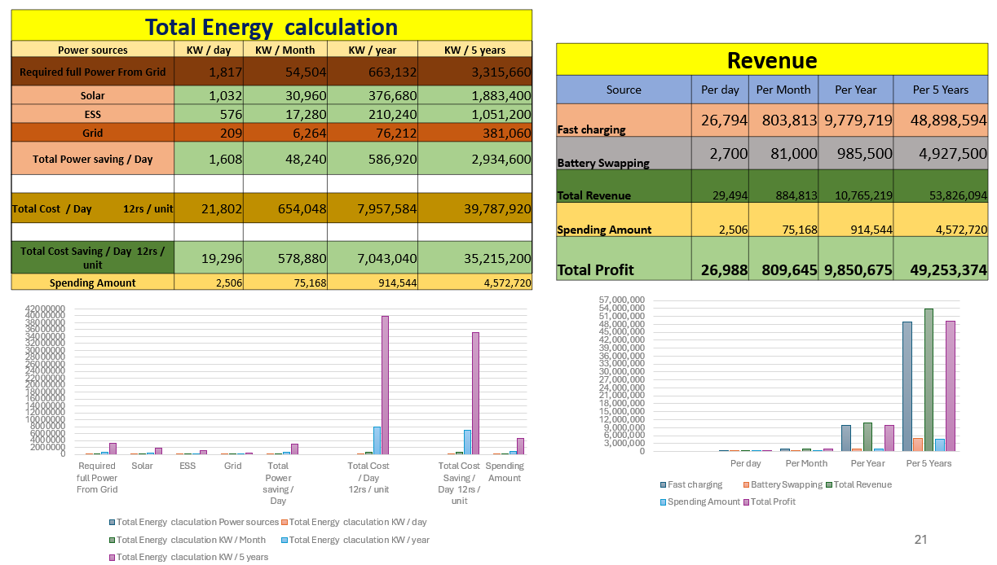
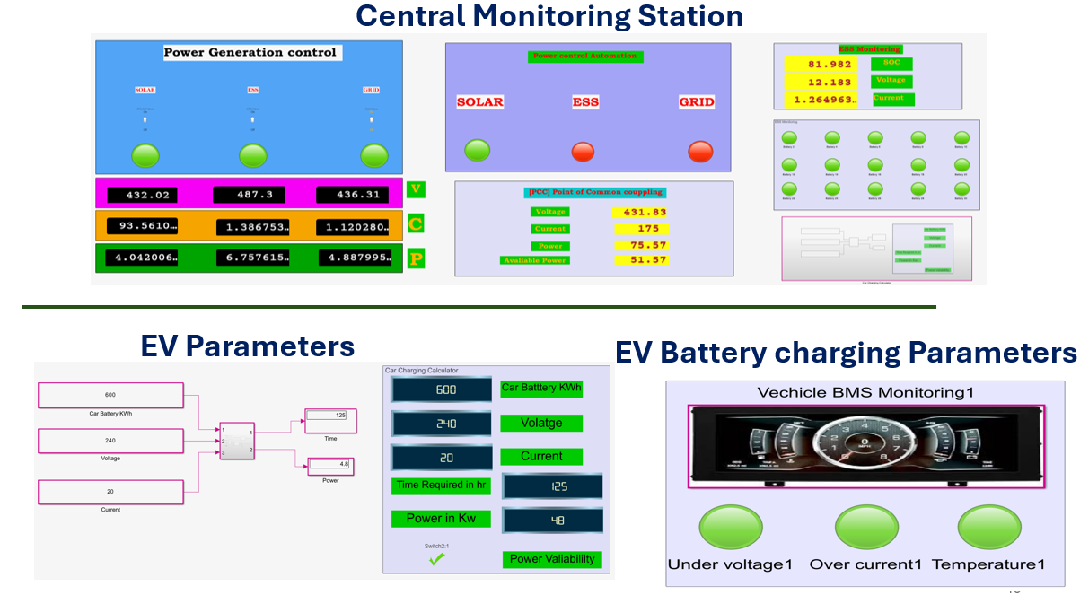

Results and Discussion
PCC
PCC Cycle
Integration & Automation
Algorithms
Model Simulation
Estimation
Monitoring
Cloud
Model Simulation
Visualization

Slide 22
Present on going Works
Tools Used
Developing Codes for H/W micro controllers – in Simulators
Developing Simulation MATLAB
Studying on ML approaches
MATLAB Simulation
Spreadsheet
Node Red
AWS
Conclusion
Publication
Energy Source Integration
Optimized Charging Solutions
Energy Cost Saving
Future Stability with IOT Connectivity
Drafting
Future Scope
Hardware prototype _ Waiting for Seed Grant

Slide 23
References
Charging Station | IoT Solutions for Electric Vehicles (EV) Charging Stations: A Driving Force Towards EV Mass Adoption
 | Power Quality Enhancement in Integrated Grid for EVs Charging Stations Using Active Filter
 | Residential Electric Vehicle Charging Station Using the Internet of Things
 | IoT enabled E-Vehicle Charging System with Battery Monitoring and Charge Scheduling
ESS | ESS Simulation based on PV Generation Prediction
Grid | IoT-based optimization of microgrid operation
 | An Efficient LoRa-Enabled Smart Fault Detection and Monitoring Platform for the Power Distribution System Using Self-Powered IoT Devices
 | Development of IoT-Based Portable Power Quality Monitoring on Microgrids by Enhancing Protection Features
 | Insulation Condition Monitoring in Distribution Power Grid via IoT-Based Sensing Network
 | Internet of Things-Aided Smart Grid: Technologies, Architectures, Applications, Prototypes, and Future Research Directions
Management Monitoring | Design of an Industrial IoT-Based Monitoring System for Power Substations
 | A Novel Sensor Placement Strategy for an IoT-Based Power Grid Monitoring System
 | State-of-Charge Equalizations Comparison in a Multi-prosumer Environment Based on Real-Time Energy Management Systems with IoT-Support
 | Intelligent IOT-based BMS for Integrated Solar with AC grid Fast Charging Systems in Electric Vehicles
 | IoT Based Electrical Vehicle Battery Management System with Charge Monitor and Fire Protection
 | An IoT -based Power Management System for EV Chargers
Solar | A Pitaya Dye-Sensitized Solar Cell Monitor for Environmental Sunlight Intensity Detection
 | Eternal-Thing: A Secure Aging-Aware Solar-Energy Harvester Thing for Sustainable IoT
Swapping | Optimal Planning of Battery Swapping and Charging Stations for the Urban Cities
 | Combining data centers with electric vehicle battery swapping stations for grid regulation
 | Battery Swapping Mobile Service Station for Electric Vehicles Application
 | Optimal dispatch of electric vehicle batteries between battery swapping stations and charging stations
 | Integration of Battery Swapping Station into Microgrid: A Review
 | Location Decision of Battery Swapping Stations Combined with Battery Swapping Warehouses
ML | Machine_Learning-Based_Method_for_Remaining_Range_Prediction_of_Electric_Vehicles
 | Prediction_of_EV_Charging_Behavior_Using_Machine_Learning
 | Reinforcement_Learning_Based_EV_Charging_Management_SystemsA_Review

Slide 24
Thankyou
*
"Engineering problems are under-defined; there are many solutions, good, bad, and indifferent. The art is to arrive at a good solution."
- Richard James

